Slide 1
Eye For Blind Using Deep Learning Techniques

Slide 2
CONTENTS
INTRODUCTION
AIM AND OBJECTIVES
RESEARCH QUESTION
LITERATURE REVIEW AND SUMMARY
RESEARCH GAP
GANTT CHART
METHODOLOGY AND WATERFALL APPROACH
DESIGN
IMPLEMENTATION
TESTING AND RESULT
CONCLUSION
FUTURE WORK
REFERENCES

Slide 3
Introduction
Image Caption Generator is used to recognize the context of an image and to generate natural sentence description for given image.
It involves the Visual Context understanding in Computer Vision and the sentence generation in Natural Language Processing.
In this the input to model is an image and the output of the model is caption generated in natural language processing.

Slide 4
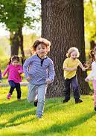
Example
when image is passed as an input to the model, it should be able to generate captions in natural language such as “ Kids are running in garden”.

Slide 5
Aim and Objectives
The aim of the project is to generate a textual and audio description when an image is passed as an input to it. The purpose of the study is to detect all the objects and attributes, recognise relationship among them and then generate captions describing all the features present in an image using Deep Learning and Natural Language Processing.
Following are the objectives :
To extract features from Images using Convolutional Neural Network techniques.
To train the model on the benchmark dataset so that it can detect multiple assets in an image, for example, objects, persons.

Slide 6
Aim and Objectives Contd.
To train the model for generating Captions or descriptions for the images at character, word, or sentence-level.
To construct the model such that it can generate detailed captions on a wide variety of image styles and scenarios.
To convert the generated textual captions into an audio format.

Slide 7
Research Questions
Following are the questions, answers to which will be found through this study.
Can Convolutional Neural Network be applied in generating captions for images correctly?
Can the use of transfer learning techniques to extract the features ease the process?
What is the difference of using Recurrent Neural Network, Long Short Term Memory, and Gated Recurrent Units as decoders on output?
How can the textual captions be helpful for visually impaired people?

Slide 8
Applications of Image Caption Generator
It can be used to assist the blind using text-to-speech.
It can be used to convert captions for images in social feed as well as messages to speech which will enhance social medial experience of users.
It can also be used for educational purposes as young children can be assisted about recognition of objects and learning the English language.
It is also helpful in field of robotics as environmental insights can be provided through natural language representation.
It can also be used for image searches and indexing purposes on internet if images present on the internet have captions.

Slide 9
Literature Review
Retrieval-Based methods
In these methods, images along with text are mapped into a common vector space. A similarity metric score is also defined for ranking purposes. Captions are retrieved using this ranking when an input image is passed to the model.
Used by: A. Farhadi et.al.,2010, M. Hodosh et.al.,2013, V. Ordonez et.al.,2011
Limitation: The disadvantage of retrieval-based methods is that they cannot generate captions for images with novel scenes or when new combinations of objects are passed as it could only feed back predefined sentences. In order to overcome this limitation, a large number of generative approaches were introduced.

Slide 10
Literature Review contd.
Templated-Based methods
In Template-based methods, sentences are generated using templates or grammar model. Image descriptions are generally done by exploiting detected objects, adjectives, and spatial relationships.
Used by: S. Li et.al.,2011 , Y. Ushiku et.al.,2015
Limitation: The problem of image captioning was generally solved through template-based methods while dealing with sub-problems. Furthermore, these methods rely on the fixed template, but because of its lack of syntactic variability, the template is not optimal.

Slide 11
Literature Review contd.
Neural Network Based methods
In these methods, the convolution Neural Networks (CNN) can be used to encode high level visual features and Recurrent Neural Networks (RNN) can be used to decode the CNN representation into a word sequence.
Used by: Vinyals et.al.,2015 , O. Russakovsky et.al.,2015 , K. Cho et.al.,2014 , Q. You et.al.,2016, P. Anderson et.al.,2018, K. Xu et.al.,2015, Z. Yang et.al.,2016 , Wang et.al.,2019
Limitation: There is one problem with the Recurrent Neural network that these networks suffer from the vanishing gradient problem which is important for this thesis.

Slide 12
Summary of Literature Review
Many of the research made use of the powerful Convolutional Neural network for extracting features and then used classifiers for various purposes.
Recurrent Neural Networks have been utilised in various forms for generating sentences and captions for images.
In nutshell, there are several research works and domains in the field of image captioning that uses CNN-RNN framework to generate captions.

Slide 13
Research Gap
There is one problem with the Recurrent Neural network that these networks suffer from the vanishing gradient problem which is important for this thesis. So, to overcome this problem, this study aims to develop the model using Gated Recurrent Unit (GRU) which is capable to resolve the problem of vanishing gradients due to the presence of logic gates, this architecture can retain information for long duration of time and pass only useful information.
Apart from this, due to the usefulness of attention layer, this model also aims to embed attention mechanism with GRU. Several other techniques such as Teacher Forcing, Greedy Search have also been used to make the system robust.

Slide 14
GANTT CHART
GANTT CHART showing weekly progress

Slide 15
Methodology
The project is aimed to develop using Waterfall Model technique in which whole steps of the development can be divided into separate stages such as Gathering Requirements, Design, Implementing the models, Verifying the model, and Maintenance.
The output of one stage is passed as an input to the next stage sequentially. Being a sequential approach, the previous stage should be completed before the beginning of the next phase.

Slide 16
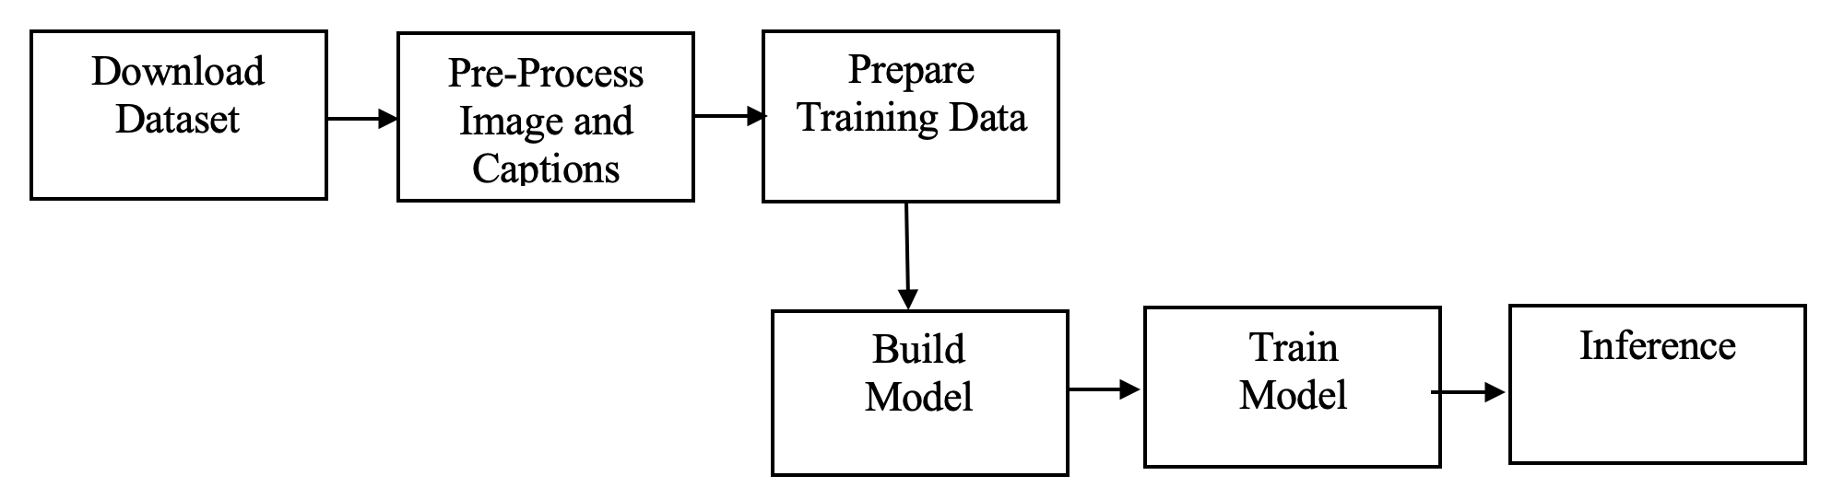
Waterfall Approach
Block diagram of Methodology adopted

Slide 17
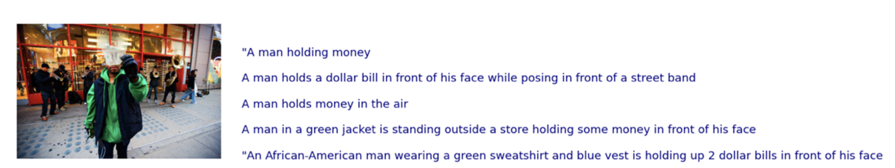
Sample ‘Image-Caption Pair’ in Dataset
Every image has 5 captions associated with it.
Sample Image-Caption Pair

Slide 18

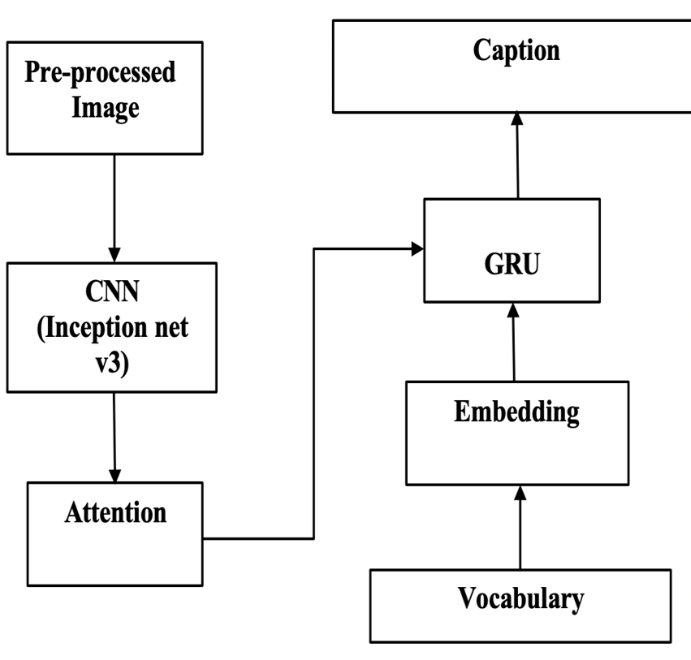
Design
The complete architecture of generating captions consists of different sub-models:
(a) Initialising weights using Inception Net V3
(b) Encoder model using Convolutional Neural Network
(c) Attention mechanism
(d) Decoder model using Recurrent Neural Network
Block Diagram of Architecture

Slide 19
Design Contd.
There are four major components present in the architecture:
Encoder: Image encodings have already been obtained using Inception net v3 model. So, the role of encoders is very simple. The encoder here accepts the image features and apply relu activation functions and then pass it to the attention model.
Sequence Decoder: Decoder consists of the recurrent network which is designed using Gated recurrent units. In this, captions are passed after passing through the embedding layer.
Attention: The role of the decoder is to generate words for output sequence. The use of attention layer is to help decoder to emphasize on the most relevant part of the image so that word can be generated for that part.
Sentence Generator: This contains several linear layers which accept the output of decoder model as input and produces a probability for each word using the vocabulary created. The probabilities are calculated using Greedy Search.

Slide 20
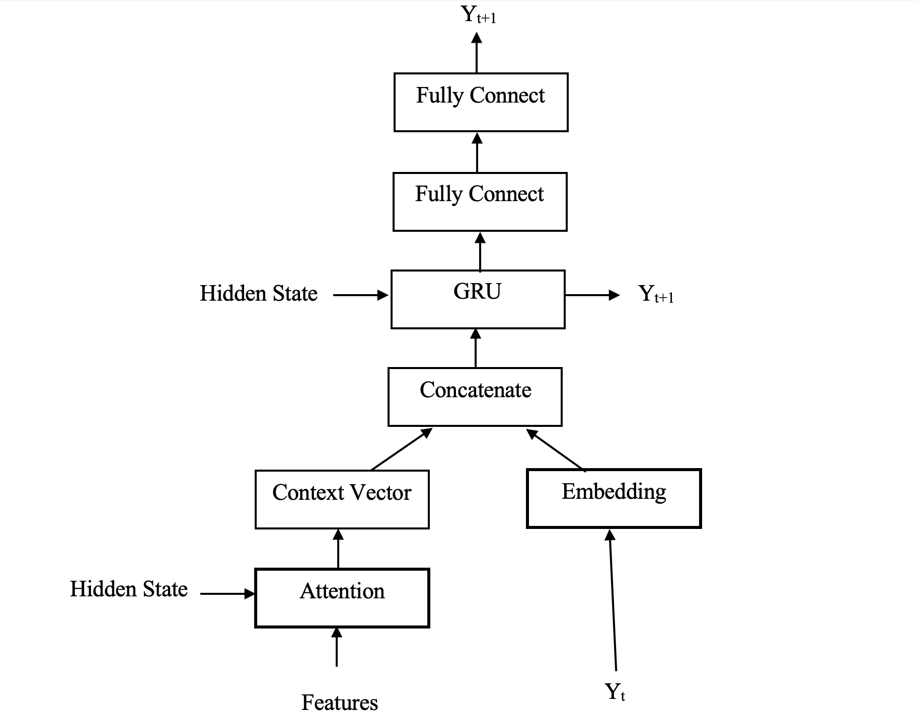
Decoder
Decoder is implemented using Gated Recurrent Unit (GRU) which solved vanishing gradients problem.
Embedding layer accepts the pre-processed input sequence. The role of embedding layer is to transform this input sequence into an embedded vector.
The input to GRU is output of attention model, a context vector, which is concatenated with embedded vector obtained from embedding layer.
Y_{t} : The input sequence for timestamp t+1 which is actual word during training. During validation and testing, this is output generated by decoder at immediate previous step at timestamp t.
Y_{t+1} : The output sequence at timestamp t+1
Decoder Architecture

Slide 21
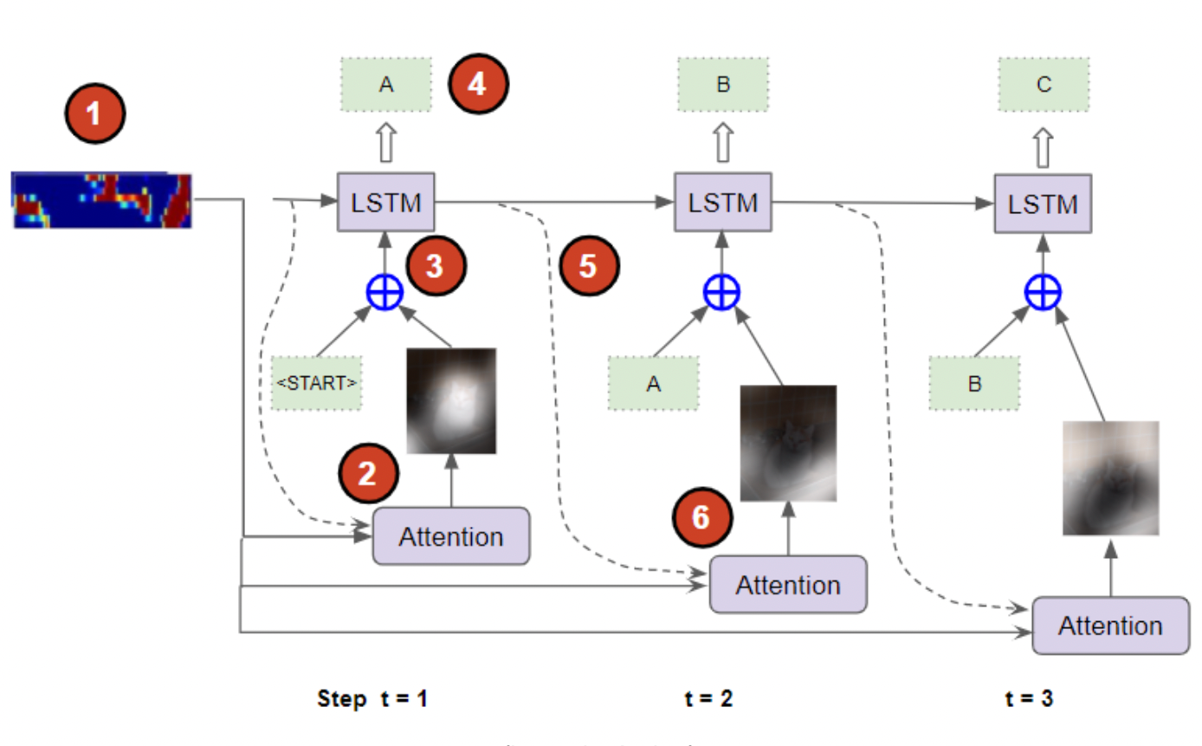
Implementation
CNN Encoder is converting the images into encoded features.
The attention layer is helping RNN to focus on relevant parts of the image rather than the complete image. At timestamp t, the embedded vector of <START> token is passed.
The output of embedding layer and attention layer concatenates and passed as an input to the RNN model.
The RNN model then generates the output sequence.
The output sequence generated at time t=1 is passed to the model at time t=2.
The hidden states of timestamp t=1 is passed to the attention layer at timestamp t=2.
The process continues until the model predicts the <END> token or maximum length is achieved.
Step-wise Implementation

Slide 22
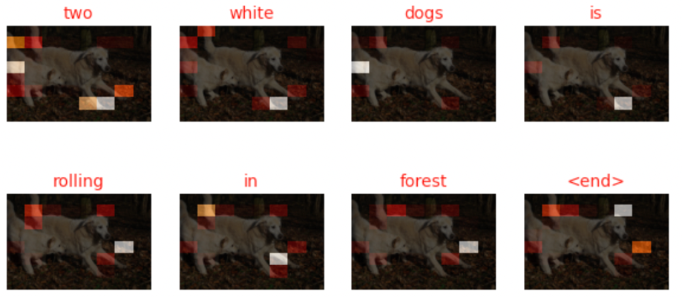
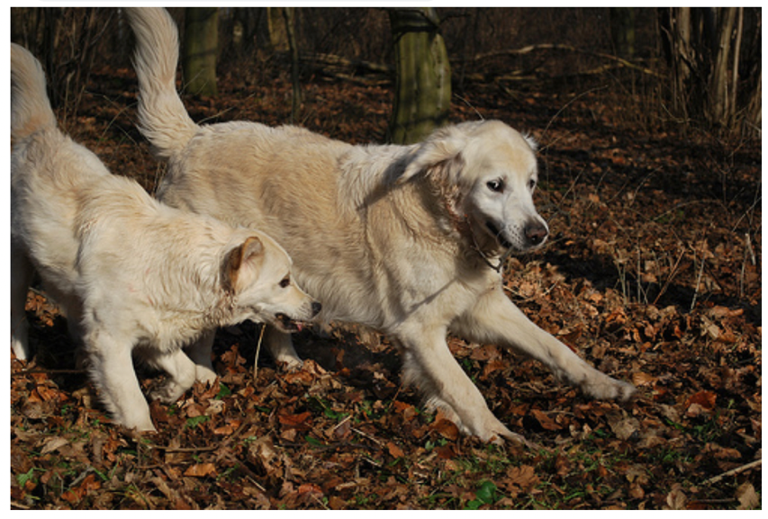
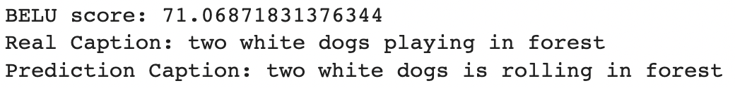

Testing
Real image
Predicting Captions
Evaluation

Slide 23
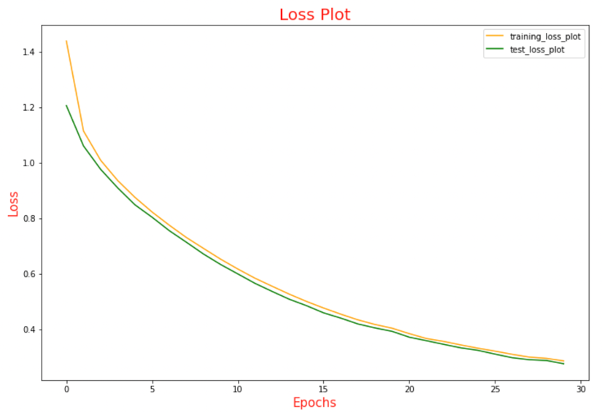
Result
The model was trained for 30 epochs and
Testing/ Validation loss reduced to 0.276.
The captions generated by the sequence
generator are also converted to audio format
using the Google Text to Speech API (online).
Training and Validation Loss

Slide 24
Conclusion
In this study, a model based on deep learning methods for generating image captions has been proposed using the data set Flickr 8K.
The proposed model used Convolutional neural network as a feature extractor which used Inception net V3 for initialising the weights. The encoded vectorised features were passed an input to the attention layer which calculated the weighted attention score and help decoder implemented using Recurrent Neural network to focus on the relevant parts of the image to generate sentence sequences based on the probabilities calculated by the Greedy Search methodologies.
Teacher Forcing technique was also used in the system to improve the accuracy of the model. The accuracy of the predictions was evaluated using BLEU score. The generated textual captions are then converted to audio format using Google Text-to-speech API to help visually impaired people.

Slide 25
Conclusion Contd.
Achievements
This model has been implemented and trained on Google Colab Pro Plus which provides the 1 V100 GPU with 53 GB RAM.
The model took approximately 30-32 mins to train on 30 epochs. The training time is less due to the usage of GRU as these are simple to use and executes faster.
The accuracy obtained is satisfactory in most of the cases and as a result, the proposed system can be used by the visually impaired people, for image search purposes and many more devices can be designed by embedding the system with slight modifications.
The validation loss of the model was reduced to 0.276 which is good.

Slide 26
Future Work
The proposed work can be improved by the use of different transfer learning technique such as Xception, ResNet for feature extraction.
The performance of the model can be enhanced by training it with a larger benchmark dataset such as Flicker 30k, MSCOCO datasets.
Instead of GRU, Long short-term memory (LSTM) can also be implemented as a decoder which is slightly complex than GRU, but may give better results.
The performance can also be improved by modifying various hyperparameters such as number of epochs, batch size, learning rate, etc.

Slide 27
References
A. Farhadi, M. Hejrati, M. Sadeghi, P. Young, C. Rashtchian, J. Hockenmaier, and D. Forsyth, Every picture tells a story: Generating sentences from images, Computer vision–ECCV 2010, (2010), pp. 15–29.
M. Hodosh, P. Young, and J. Hockenmaier, Framing image description as a ranking task: Data, models and evaluation metrics, Journal of Artificial Intelligence Research, 47 (2013), pp. 853–899.
O. Vinyals, A. Toshev, S. Bengio, and D. Erhan, Show and tell: A neural image caption generator, in Proceedings of the IEEE conference on computer vision and pattern recognition, 2015, pp. 3156–3164.
O. Russakovsky, J. Deng, H. Su, J. Krause, S. Satheesh, S. Ma, Z. Huang, A. Karpathy, A. Khosla, M. Bernstein, A. C. Berg, and L. Fei-Fei, ImageNet Large Scale Visual Recognition Challenge, International Journal of Computer Vision (IJCV), 115 (2015), pp. 211–252.
S. Li, G. Kulkarni, G. L. Berg, a. C. Berg, and Y. Choi, Composing simple image descriptions using web-scale n-grams, in Proceedings of the Fifteenth Conference on Computational Natural Language Learning, Association for Computational Linguistics, 2011, pp. 220–228.
V. Ordonez, G. Kulkarni, and T. L. Berg, Im2text: Describing images using 1 million captioned photographs, in Advances in Neural Information Processing Systems, 2011, pp. 1143–1151.

Slide 28
THANK YOU

